Slide 1
Automated Cartography Solutions (ACS)
Providing A New Automated Mapping Solution

Slide 2
Our Members
Jake Streett – App Developer
Scott Efird – Server and Database Developer
Sam Smith – Test Pilot and Website Developer

Slide 3
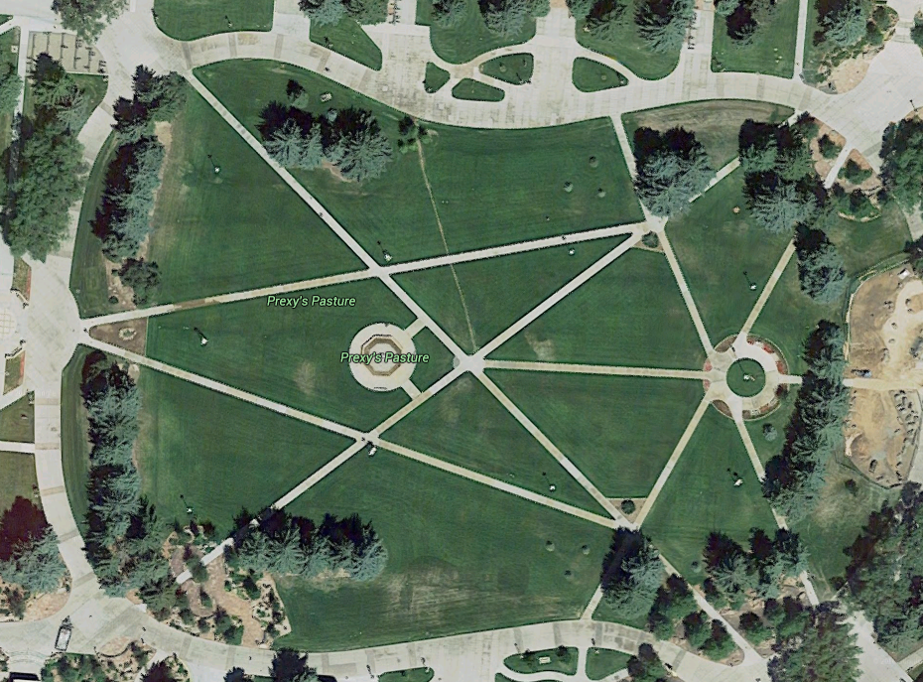
The Problem
Google Maps provides users with satellite images of the world. That is great, but the images are update infrequently (1-3 years)

Slide 4
Potential Uses
Who needs more update maps?
Open face mines
Construction companies
Farmers
Disaster Reconnaissance

Slide 5
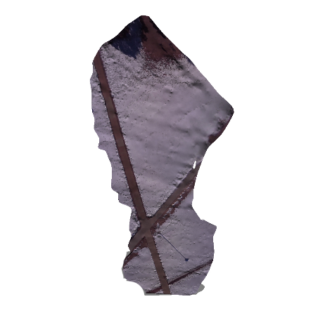
The Solution
Automated Cartography Solutions.
What is required?
A Phone and a Drone

Slide 6
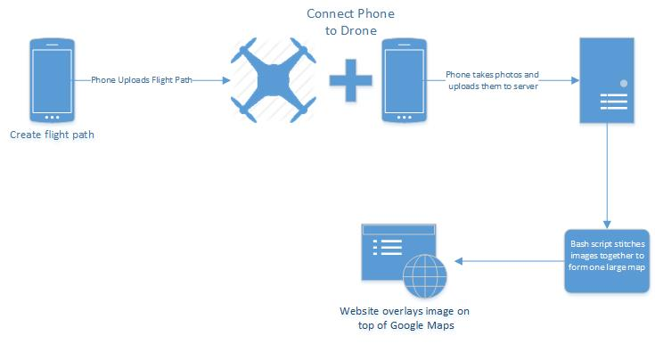
Project Overview

Slide 7
Cost
AeroSky P 12 Quadcopter “ready to fly” = 450.00
OtterBox Defender Series Case = 50.00
If needed, a cheap smart phone

Slide 8
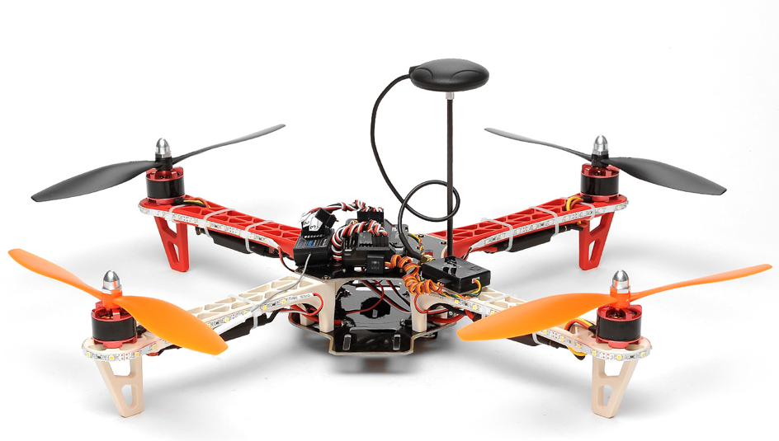

Drone
Lipo-Battery
2200 mAh ~ 20 minutes flight time
APM 2.5 autopilot board
3-axis gyro
Accelerometer
U-blox NEO-6M GPS module
Accuracy:
Position 2.5 m CEP
SBAS 2.0 m CEP

Slide 9
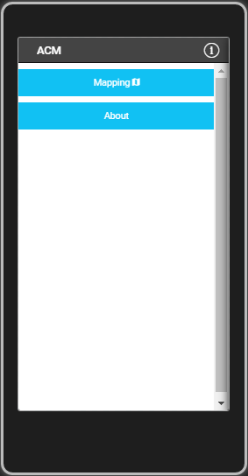
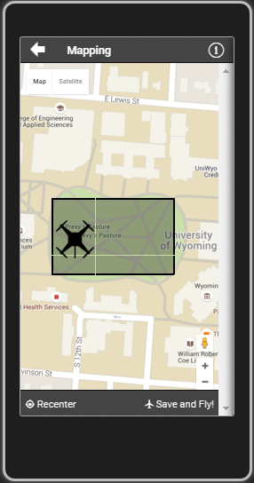
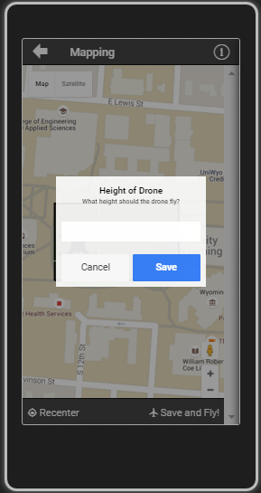

ACS App

Slide 10
App Overview
Cross Platform app utilizing:
AngularJS (1.4)
Apache Cordova (3.5.1)
Ionic(1.2.4)
jQuery
Creates flight path
Takes photo
Upload photos to the server

Slide 11
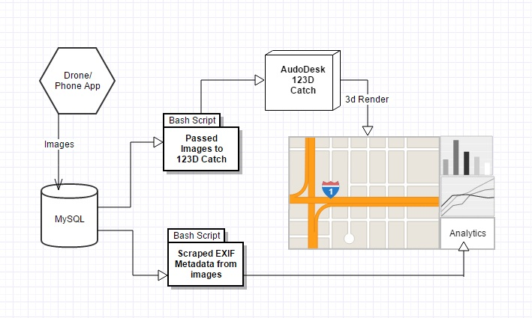
Server Infrastructure Overview

Slide 12

Primary Database Server
Running Xubuntu 15.10
Uses MySQL
Meta Data
Image Locations
Uses several bash scripts
to process the images
HP ProLiant DL320

Slide 13
Server Side Code
Formats images to a uniform size
Scrapes image metadata
Enforces image naming conventions
Creates a master content list
Passes images to Autodesk 123D Catch

Slide 14
Autodesk 123D Catch
Creates 3D objects using a large set of images
Originally we created a system using ImageMagick and Javascript
Now we record video with the phone and scrape images from it using VLC Player

Slide 15
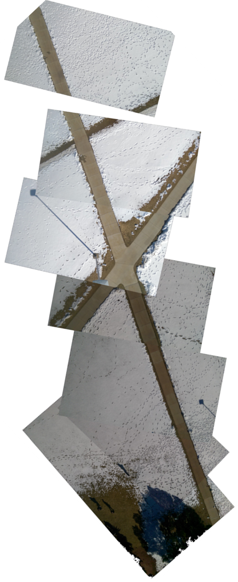
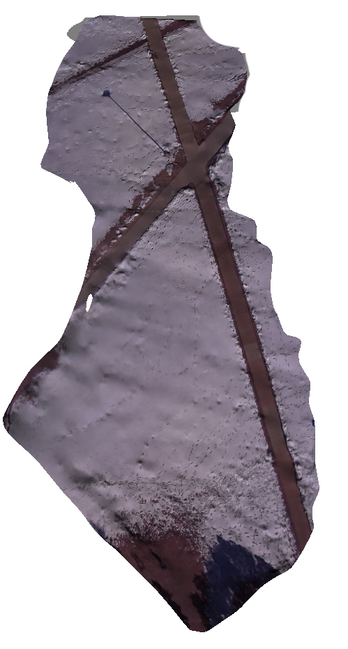
Original map
Autodesk Render

Slide 16
Overview

Slide 17
Analytical Information
Average speed
Estimated distance between images
GPS information
Meta-Data from picture
Notes:
Could be compiled into an automated report that can be emailed to the user after each flight.

Slide 18
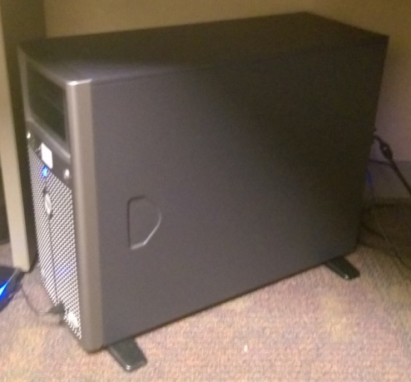
Website
Using Bootstrap, Ajax and JavaScript
Acts as a hub for all our public facing webpage
In the future, directly tie into the app

Slide 19
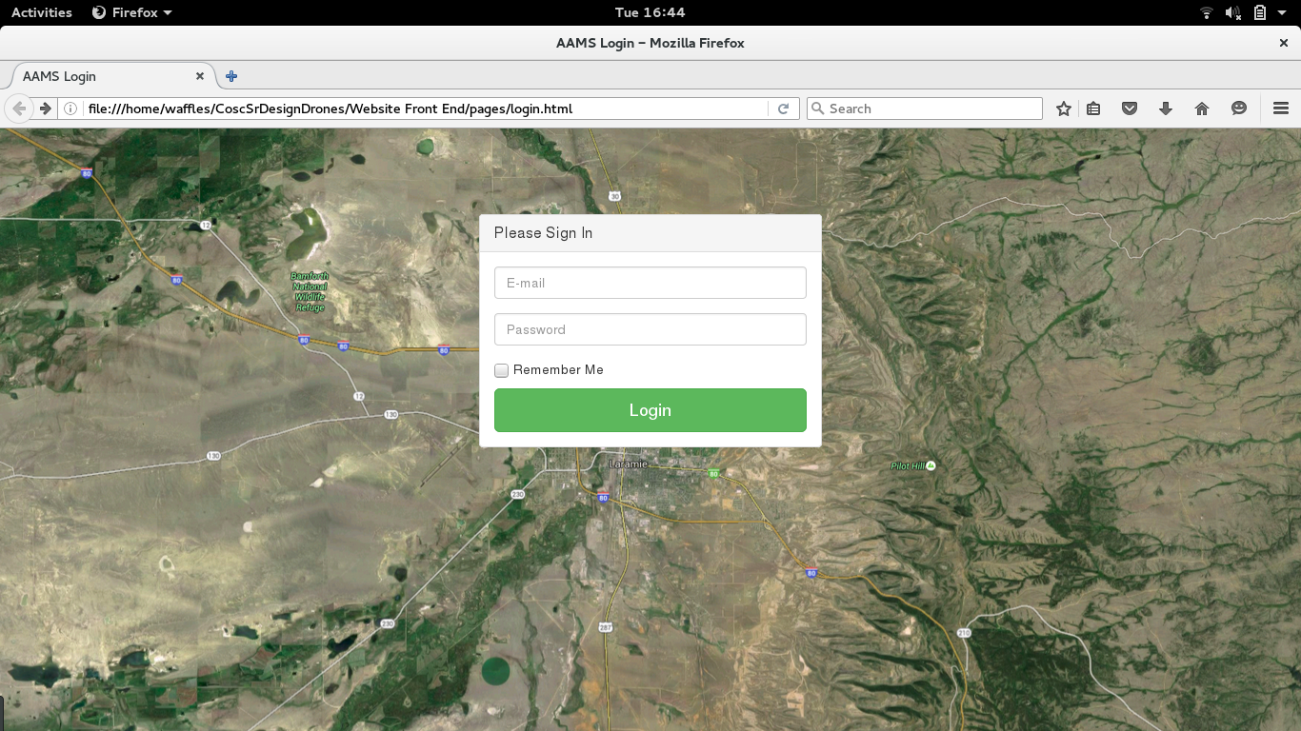
Secure Web Login

Slide 20
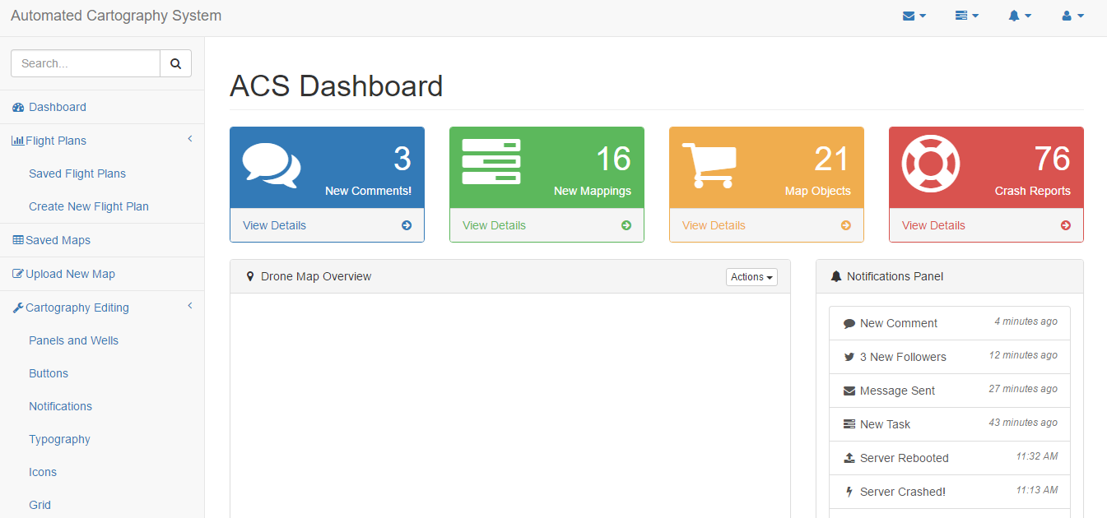
Reporting Tools

Slide 21
Future Improvements
Low cost hardware upgrades
Sonar
Hexa-Copter
Fly drone and software to Cloud
Automatically generated reports
Camera stabilizing mount
Real time video rendering

Slide 22
Q
A
&

